Slide 1

Time Series Forecasting MSc industry Project -Praneeth Jadcherla 209052391

Slide 2
Aim of the Project
The main purpose of the project is to develop an application that performs analysis on various time series models and visualize them to the users. This facilitates the user to choose the most accurate models among those models.
This project will save the time and resources to organizations.
There will not be 100% accurate predictions but based on the results of model predictions, user can choose the most accurate model and can perform forecasting at different levels of business.

Slide 3
Tools and Technologies used
Programming language: Python
Notebook/IDE: Jupyter(Anaconda)
Data visualization libraries: Matplotlib, Plotly and Plotly.express
Model fitting libraries: pmdarima, fbprophet
Performance measurement: sklearn.metrics
Interactive Dashboard libraries: Voila, ipywidgets, IPython.display

Slide 4
Existing System
There are multiple time series models developed and available in the outside world.
The challenge is that one model works better for one of the businesses but the same model does not work for other businesses.
There is no efficient model which performs with a high level of accuracy for all the businesses.

Slide 5
Proposed System
This system varies from the existing system where it helps to apply various time series models for different datasets and select the most accurate one among them.

Slide 6
What is Time Series
Time series is a sequence of data points indexed in a time order.
A set of observations on the values that a variable takes at different times and those values are in a series of time periods or intervals
Examples:
Forecasting unemployment for a state each quarter.
Rainfall measurements
Prediction of Stock Prices
Monthly subscribers
Heartbeats per minute

Slide 7
Why time series?
Trends
Systematic patterns
Data visualizations
Predict the likelihood of future events

Slide 8
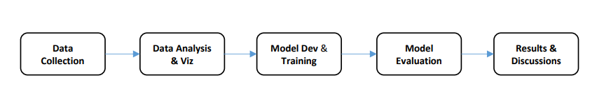
Methodology

Slide 9
Data Collection
The main data source used for the analysis of this project is Yahoo Finance website https://uk.finance.yahoo.com/.
Yahoo Finance provides free stock quotes, up-to-date news, portfolio management resources, international market data, mortgage rates, etc.
Historic data of Stock prices of Companies in all over the world

Slide 10
Downloaded the below datasets from Yahoo finance website
Stocks Company | Frequency | Year range
BP | Daily | 2012-2022
UK oil and gas investments | Daily | 2010-2020
Accenture | Daily | 2008-2018
HSBC | Daily | 2012-2022
Volkswagen (VOW.DE) | Daily | 2010-2020
Apple | Weekly | 2012-2022
HP | Weekly | 2010-2020
Walmart (WMT) | Weekly | 2008-2018
Tesco (TSCO.L) | Weekly | 2012-2022
United Health (UNH) | Weekly | 2010-2020
Coca-Cola (KO) | Monthly | 2012-2022
Vodafone (VOD.L) | Monthly | 2010-2020
JPMorgan (JPM) | Monthly | 2008-2018
AstraZeneca (AZN.L) | Monthly | 2012-2022
Starbucks (SBUX) | Monthly | 2010-2020

Slide 11
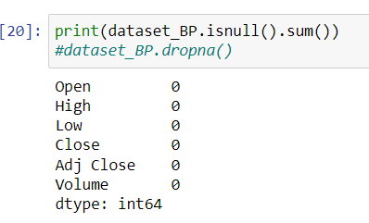
Data pre-processing
Data Cleaning
Null Values
Missing values and dates
Handling the missing values – Deleted null and missing values

Slide 12
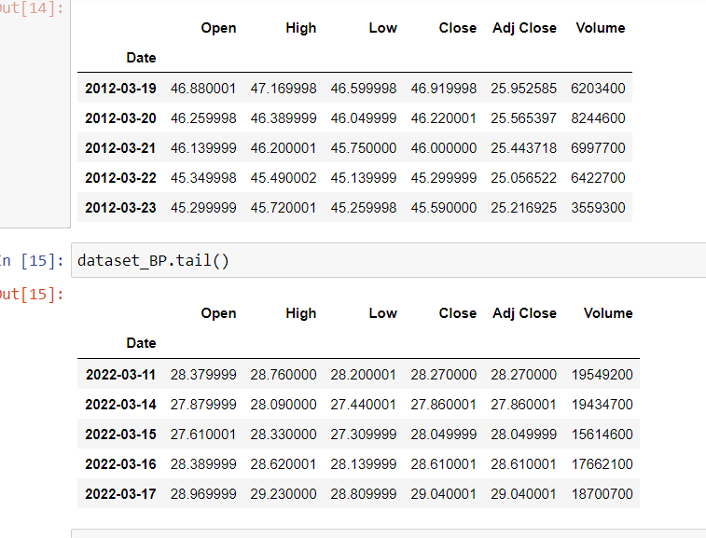
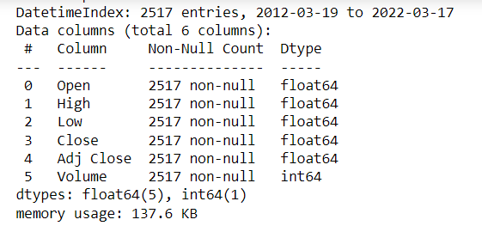
Changed the index to date time index and statistics of the attribute OF HSBC DaILY DAtset

Slide 13
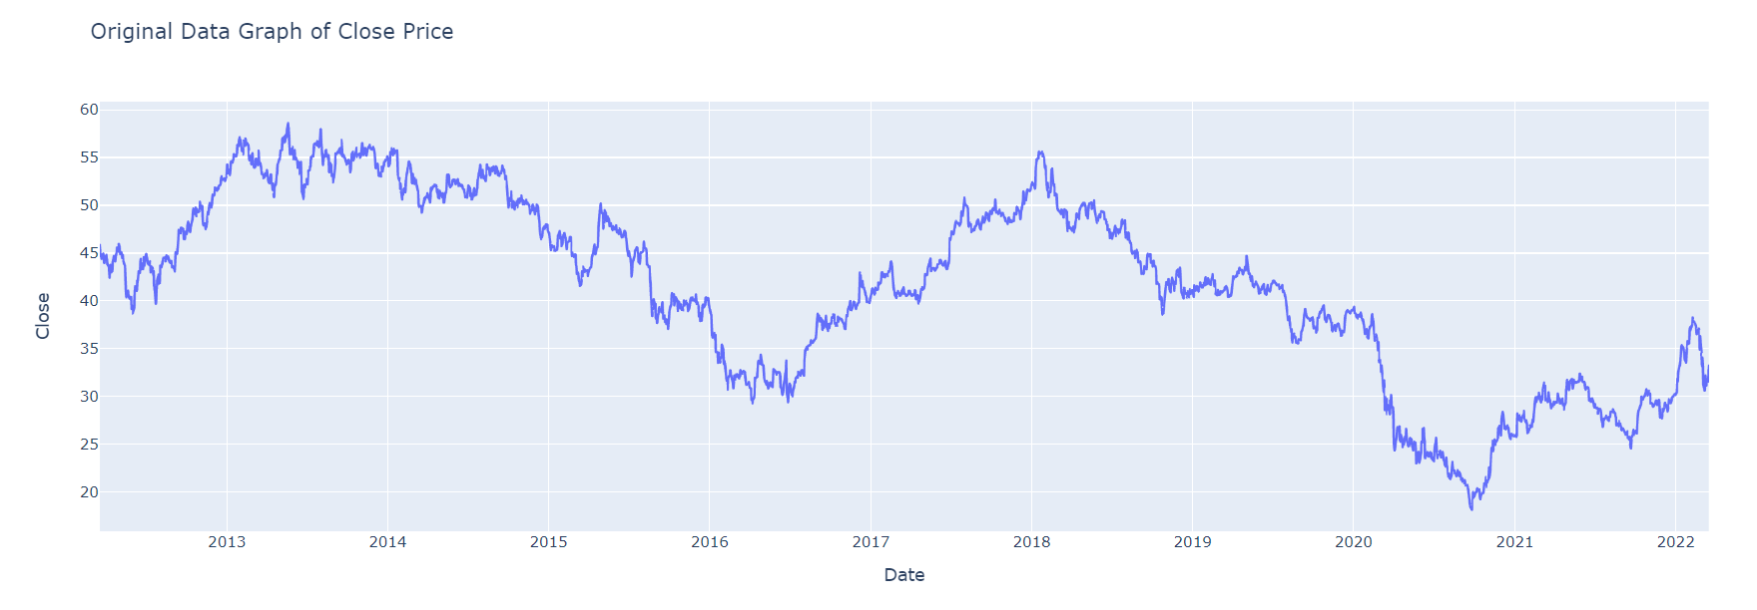
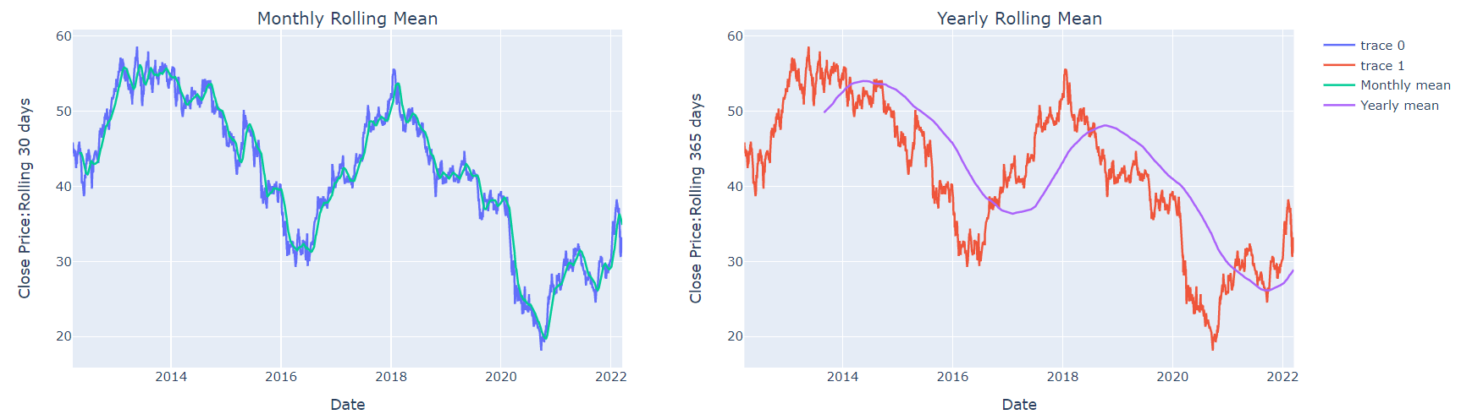
Exploratory data analysis

Slide 14
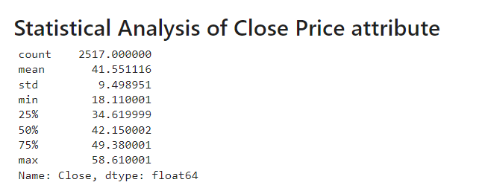
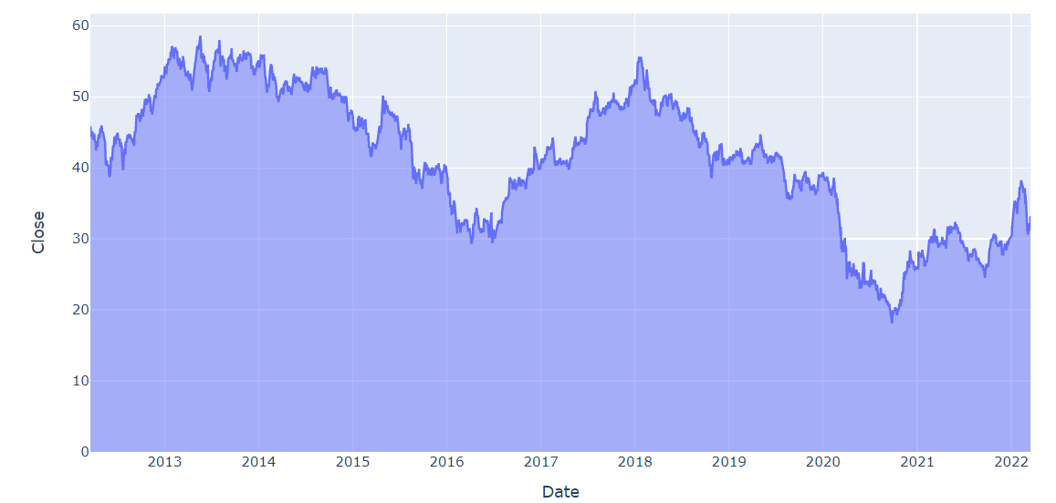
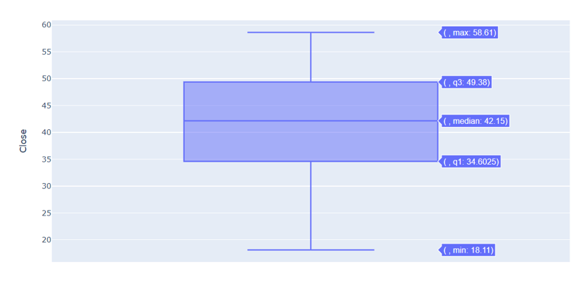
Data Visualization

Slide 15
Model Selection
Arima model
Seasonal Arima model
Facebook Prophet

Slide 16
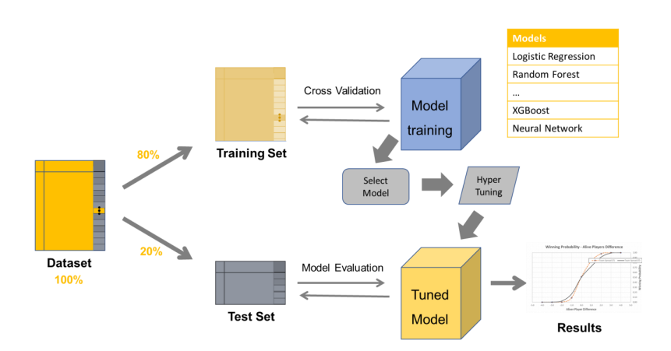
Model Development and training

Slide 17
ARIMA MODEL
AR – Auto regressive
I – Integrated
MA – Moving Average
ARIMA (p, d, q):
p - the number of lag observations in the model
d - the number of times that the raw observations are differenced
q – the size of the moving average window

Slide 18
Auto-Arima Parameters
start_p, start_q
max_p, max_q
Test=‘adf’ – Dicky fuller test to find optimal d
D=None – Let model determine d
Seasonal=False
Stepwise=False

Slide 19
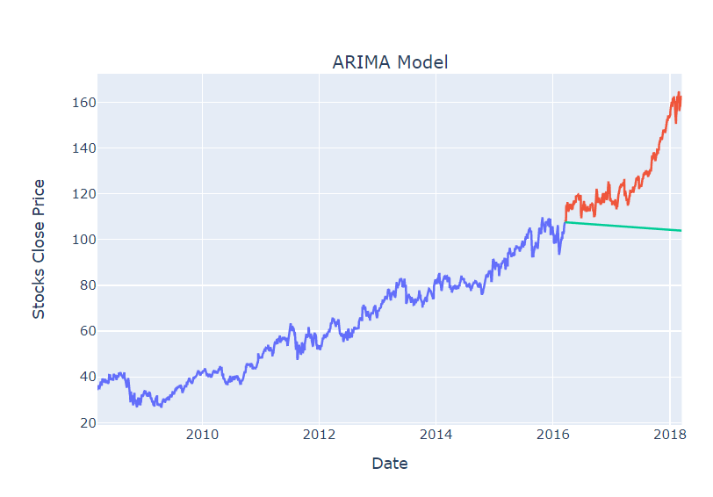
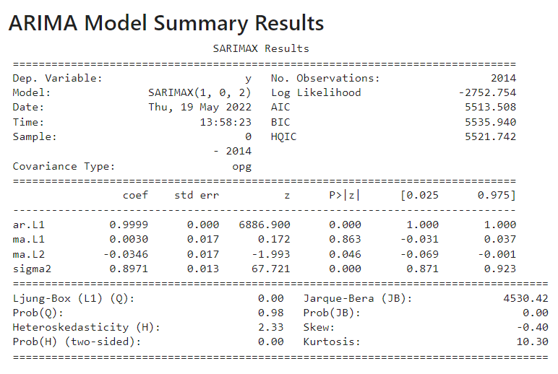
ARIMA Results
Summary results
Accenture stock Daily Price

Slide 20
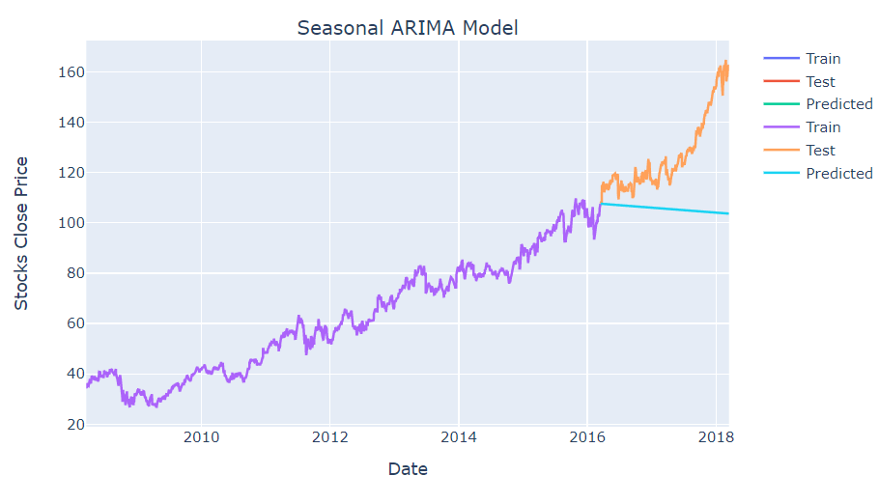
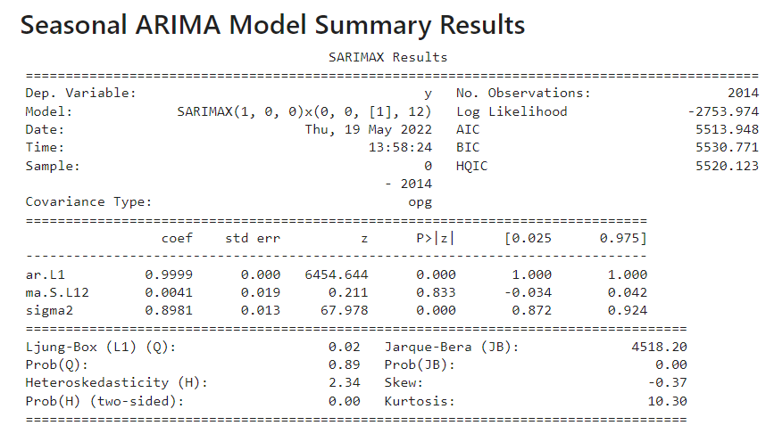
Seasonal ARIMA parameters
m=12 , frequency of series
Seasonal=True

Slide 21
Facebook Prophet model
Accurate and Fast
Reliable
Fully Automatic
Tunable Forecasts
Available in R and Python

Slide 22
Fb Prophet model parameters
Trend parameters :
growth, changepoints, changepoint_prior_scale
Seasonality and holiday parameters:
Yearly, weekly, daily, holidays, holiday_prior_scale,
seasonality_prior_scale
Plot components

Slide 23
Dashboard
Voila
Jupyter
Localhost Server
Output cell 1
Output cell 2
Output cell 3

Slide 24
Voila
Convert a jupyter notebook into interactive dashboard
Secure and customizable
Standalone Application
Jupyter server extension
Third party widgets

Slide 25
Customization of Voila
Changing the Theme
Control of nbconvert template
Create your own template
Adding our own static files

Slide 26
Deployment of Voila
Cloud service providers: Binder, Heroku, Google App Engine
Running voila on private servers
Sharing voila applications with ngrok

Slide 27
Measuring AccuracY
R2 Score
Variance – how far observed values differ from the average predicted values
The proportion of the variation in the dependent variable that is predictable from the independent variable
Coefficient of Determination

Slide 28


Mathematical Formula
R2= 1- SSres / SStot
SSres – residual sum of squares =
Sstot – total sum of squares =
yi – Observed(actual values)
fi – Predicted values
ȳ - Mean of the observed data
Sklearn.metrics library
Best possible score is 1.0

Slide 29
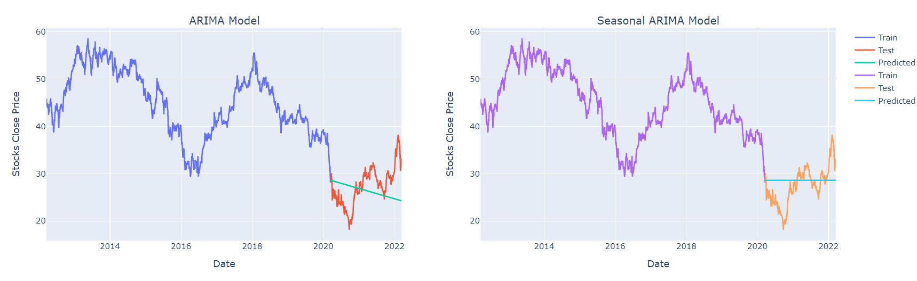
Accenture Daily
HSBC Daily
Model | R2 Score
ARIMA | -2.16
SARIMA | -2.19
FB Prophet | 0.37

Slide 30
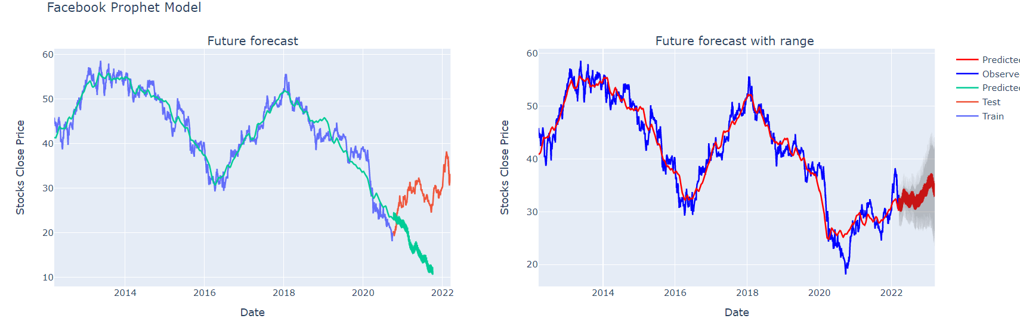
Model | R2 Score
ARIMA | -0.6
SARIMA | -0.08
FB Prophet | -13.23

Slide 31
Future Work
Customizing the dashboards according to user requirements(include column names in the dropdowndropdown)
Can include more accuracy errors
This dashboard is only implemented for Stocks datasets. We can modify and reuse the code to implement for all types of datasets.
Can add more time series models

Slide 32
Thank you!

